Slide 1
Principal Component Analysis (PCA)
Dr. Umberto Michelucci
umberto.michelucci@toelt.ai

Slide 2
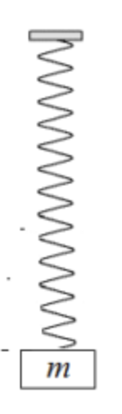

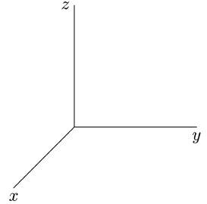




Measurement of the position of the mass m at different time points $t_{i}$
For each $t_{i}$ 2 measurements
In the plane of the objective
For each $t_{i}$ 2 measurements
In the plane of the objective
Only 1 measurement (the distance of the
mass $m$ from a point along the spring) is
necessary.
For each $t_{i}$ 2 measurements
In the plane of the objective

Slide 3
PCA – An intuitive understanding
PCA does nothing else than expressing the original data on a new basis that has been obtained by a linear combination of the original basis vectors.
Note: PCA does *NOT* reduce the number of dimensions!!

Slide 4
Change of basis
The measure of intelligence is the ability to change
--Albert Einstein.

Slide 5
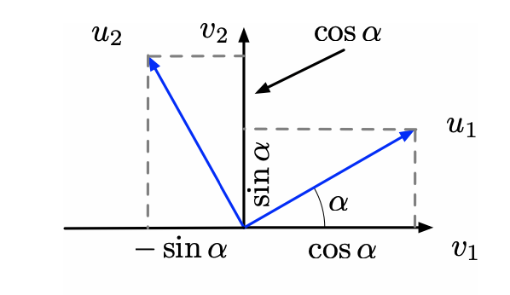
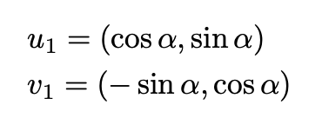
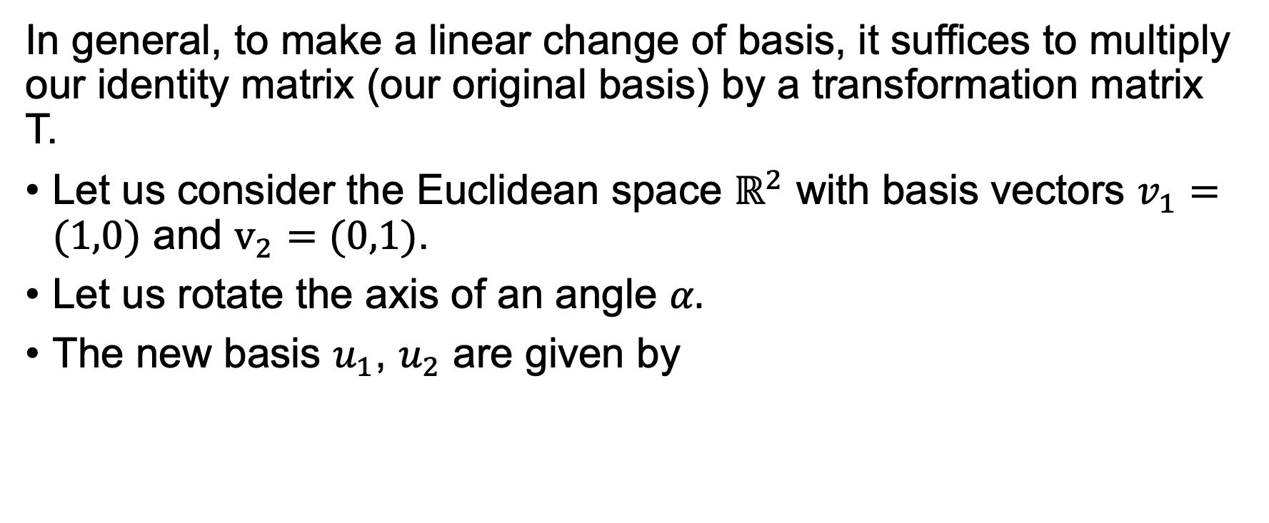
Change of basis
In general, to make a linear change of basis, it suffices to multiply our identity matrix (our original basis) by a transformation matrix T.
Let us consider the Euclidean space $ℝ^{2}$ with basis vectors $v_{1}=(1,0)$ and $v_{2}=(0,1)$.
Let us rotate the axis of an angle $α.$
The new basis $u_{1}$, $u_{2}$ are given by

Slide 6
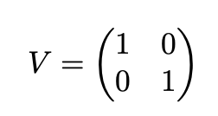
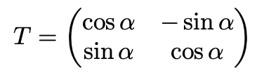
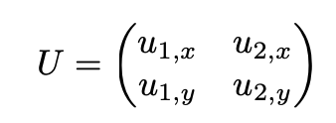

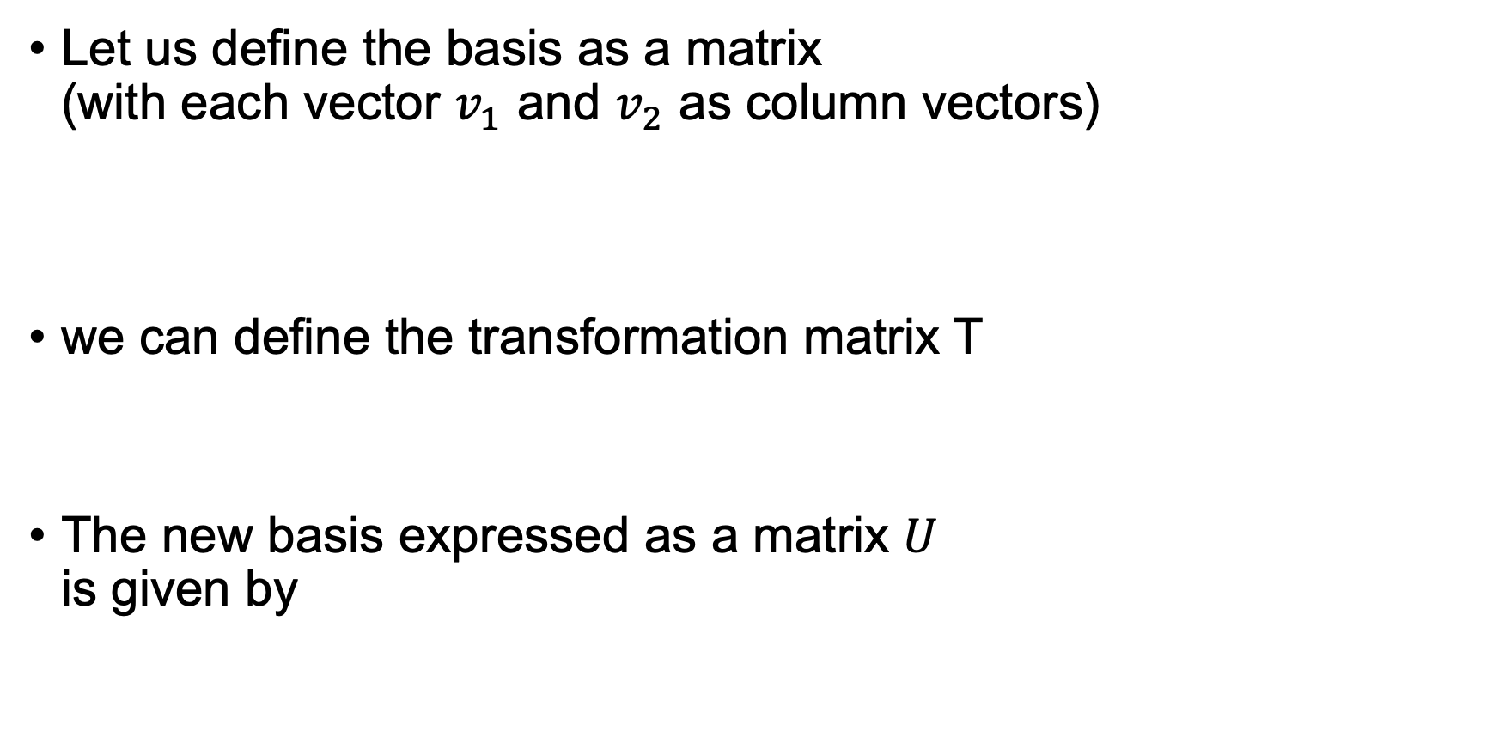
Change of basis
Let us define the basis as a matrix (with each vector $v_{1}$ and $v_{2}$ as column vectors)
we can define the transformation matrix T
The new basis expressed as a matrix $U$ is given by

Slide 7
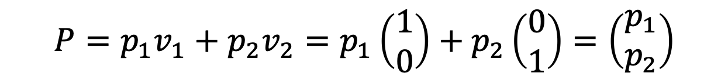
Change of basis
Let us consider a generic vector
P in the new basis can be expressed as
$$P=p_{1}v_{1}+p_{2}v_{2}=p_{1}\left(\begin{matrix}1 \\ 0\end{matrix}\right)+p_{2}\left(\begin{matrix}0 \\ 1\end{matrix}\right)=\left(\begin{matrix}p_{1} \\ p_{2}\end{matrix}\right)$$
$P_{u}=TP=\left(\begin{matrix}\cos{α} & −\sin{α} \\ \sin{α} & \cos{α}\end{matrix}\right)$ $\left(\begin{matrix}p_{1} \\ p_{2}\end{matrix}\right)$= $\left(\begin{matrix}p_{1}\cos{α−p_{2}\sin{α}} \\ p_{1}\sin{α+p_{2}\cos{α}}\end{matrix}\right)$

Slide 8
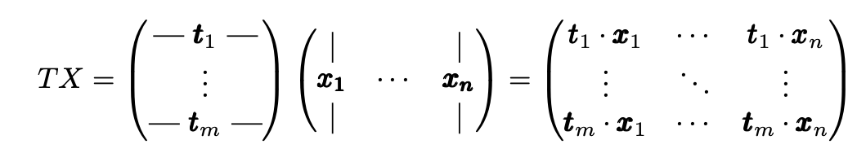

Change of basis
Considering a generic dataset $X$, it can be expressed in a new basis as $Y$ as

Slide 9
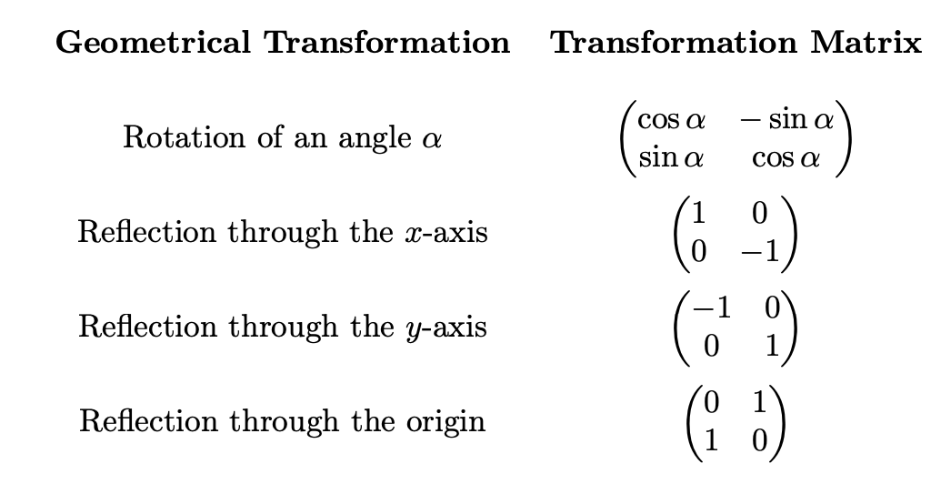
Example of transformations

Slide 10
Open Questions
What is the best way to re-write our dataset X? Or in other words, how can we decide what is a good and what is a bad representation (or in other words a good or bad basis)?
What is a good choice for T?

Slide 11
PCA Key Assumptions
The directions along which the data show the largest variance are the ones that contain the most relevant and interesting information.
Features that are correlated to each other are redundant, or in other words not useful in describing the phenomena we are studying.

Slide 12
PCA Key Assumptions
The directions along which the data show the largest variance are the ones that contain the most relevant and interesting information.
Features that are correlated to each other are redundant, or in other words not useful in describing the phenomena we are studying.
Hypothesis 1 can be grasped by considering that if there is minimal variance along a certain direction, it implies that the data remain largely unchanged in that direction, suggesting a lack of significant information.

Slide 13
PCA Key Assumptions
The directions along which the data show the largest variance are the ones that contain the most relevant and interesting information.
Features that are correlated to each other are redundant, or in other words not useful in describing the phenomena we are studying.
Hypothesis 1 can be grasped by considering that if there is minimal variance along a certain direction, it implies that the data remain largely unchanged in that direction, suggesting a lack of significant information.

Slide 14
Covariance Matrix
Never think that lack of variability is stability. Don't confuse lack of volatility with stability, ever.
-- Nassim Nicholas Taleb

Slide 15
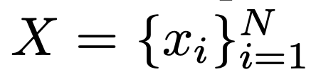
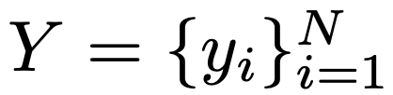
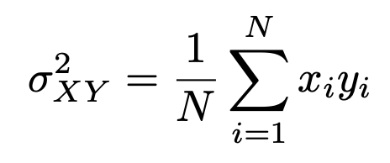
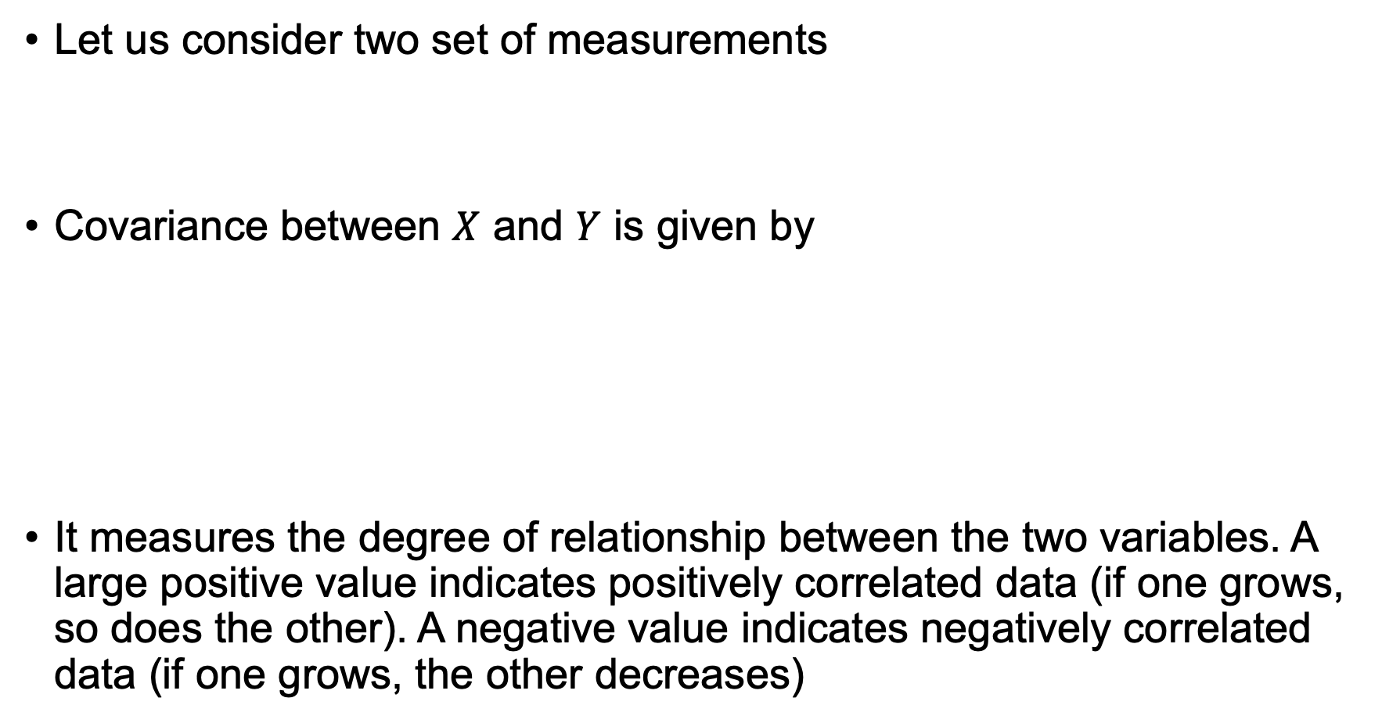
Covariance Matrix
Let us consider two set of measurements
Covariance between $X$ and $Y$ is given by
It measures the degree of relationship between the two variables. A large positive value indicates positively correlated data (if one grows, so does the other). A negative value indicates negatively correlated data (if one grows, the other decreases)

Slide 16
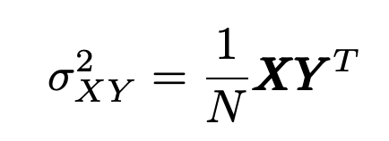
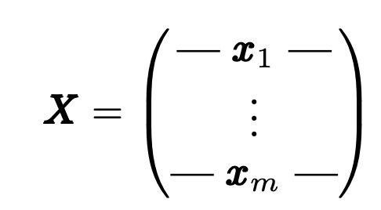
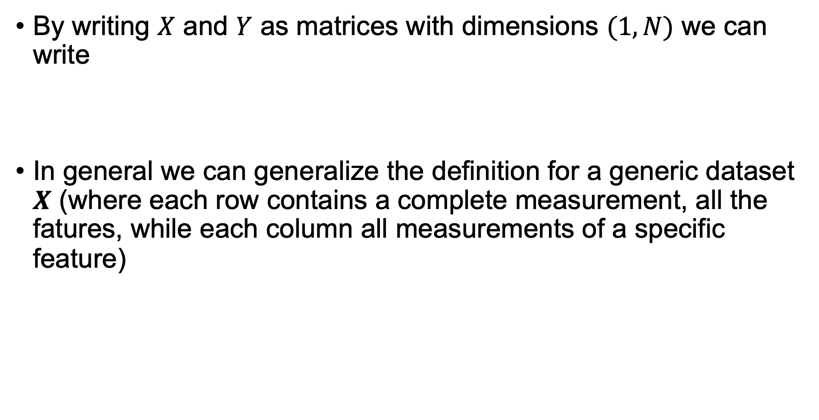
Covariance Matrix
By writing $X$ and $Y$ as matrices with dimensions $(1,N)$ we can write
In general we can generalize the definition for a generic dataset $X$ (where each row contains a complete measurement, all the fatures, while each column all measurements of a specific feature)

Slide 17
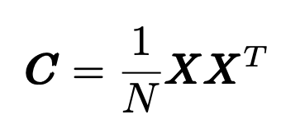
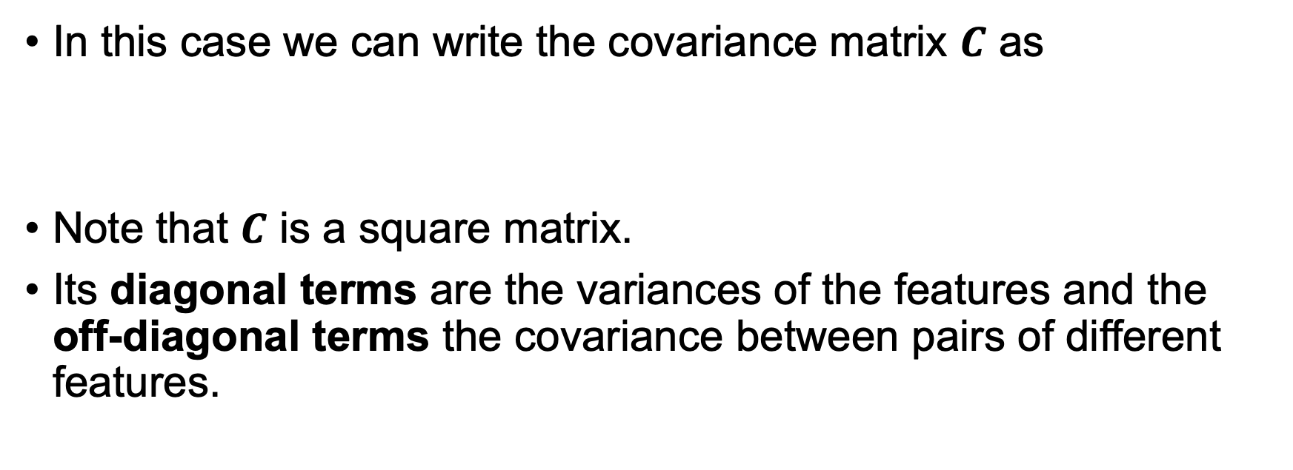
Covariance Matrix
In this case we can write the covariance matrix $C$ as
Note that $C$ is a square matrix.
Its diagonal terms are the variances of the features and the off-diagonal terms the covariance between pairs of different features.

Slide 18
Covariance Matrix and PCA
Remembering our hypothesis, that what is interesting happens along direc- tions that have large variance and small co-variance (low redundancy), we can make the following statements:
Large diagonal elements indicate interesting features
large off-diagonal terms indicate large redundancy
You may, at this point, see where we are going with this…

Slide 19
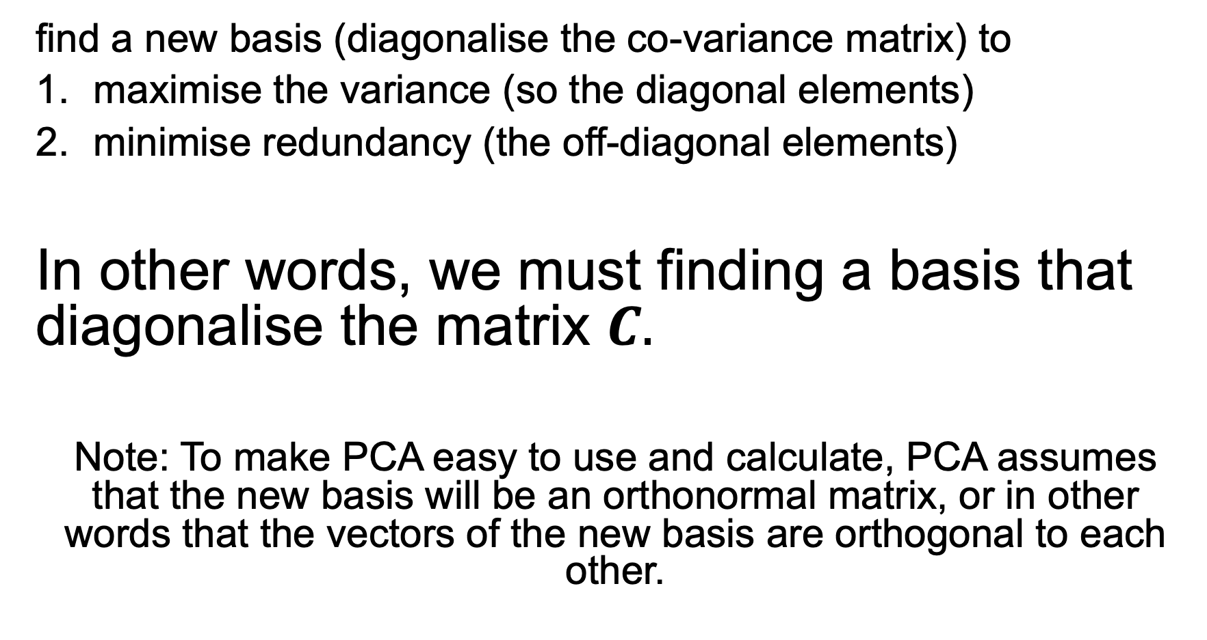
What we must do
find a new basis (diagonalise the co-variance matrix) to
maximise the variance (so the diagonal elements)
minimise redundancy (the off-diagonal elements)
In other words, we must finding a basis that diagonalise the matrix $C.$
Note: To make PCA easy to use and calculate, PCA assumes that the new basis will be an orthonormal matrix, or in other words that the vectors of the new basis are orthogonal to each other.

Slide 20
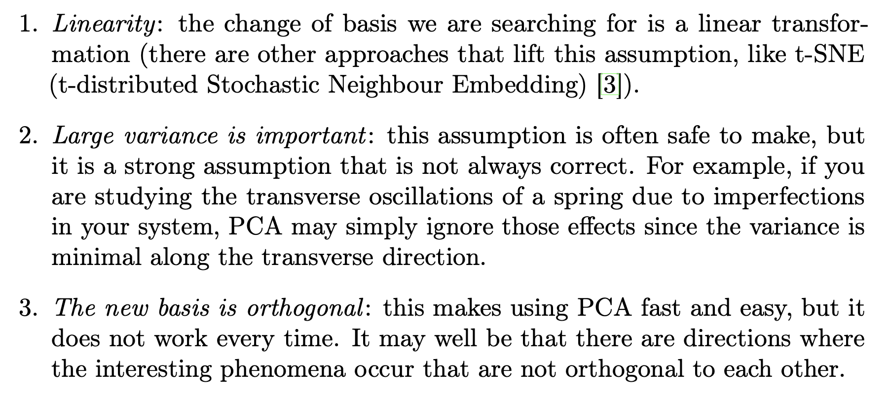
PCA – The Key Assumptions

Slide 21
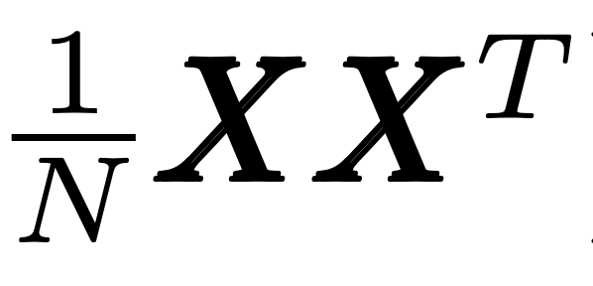


PCA – How to diagonalise $C$
We will not prove this but it is enough to choose as the transformation matrix $T$ one that has for each row an eigenvector of the matrix

Slide 22
PCA – Dimensionality Reduction
PCA does not do dimensionality reduction. This is achieved by keeping the «top» 2 (or 3,4, etc.) of the new dimensions.

